Slide 1

NYPD Shooting Incident Analysis Using Data Analytics
Submitted by: Sahana Timmappa Naik

Slide 2
Agenda:
Introduction
Problem Statement
Project Objectives
Dataset Description
Data Preprocessing
Exploratory Data Analysis (EDA)
Machine Learning Models
Model Evaluation & Comparision
Dashboard & Visualizations
Results & Insights
Conclusion
Future Scope

Slide 3

Introduction:
Shooting incidents are a serious concern in urban areas.
Analyzing crime data helps in understanding patterns and trends.
This project uses data analysis techniques to study NYPD shooting incidents and derive meaningful insights.

Slide 4
Problem Statement:
Understanding crime patterns is difficult without proper data analysis.
Authorities need insights to identify high-risk areas and take preventive measures.
This project aims to analyze shooting incidents to support better decision-making.
Project Objectives:
Analyze shooting incident trends
Identify high-risk locations
Study victim and perpetrator demographics
Compare murder and non-murder incidents
Create an interactive dashboard

Slide 5
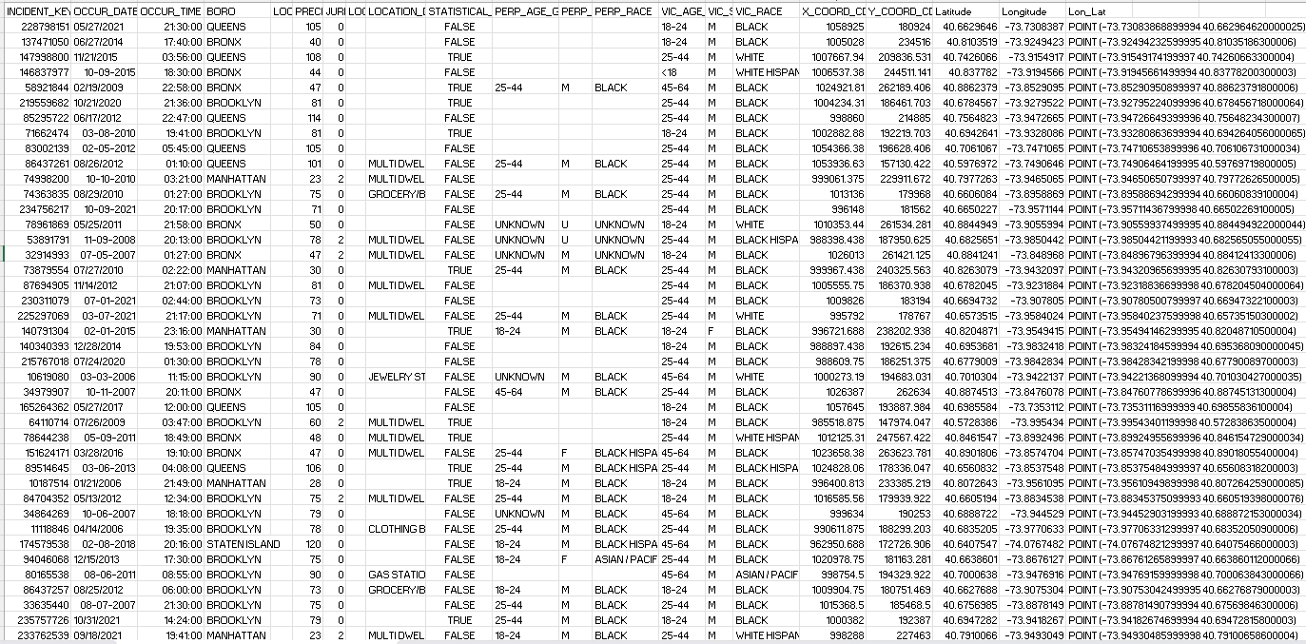
Dataset Description:
The dataset contains historical shooting incident data from NYPD.
It includes:
Year, Date and time of incident
Borough and location details
Victim age, gender, and race
Perpetrator details
Murder flag (fatal or non-fatal)

Slide 6
Data Preprocessing:
Data preprocessing is performed to clean and prepare the dataset:
Missing values were handled
Date and time columns were formatted
Duplicate records were removed
Irrelevant columns were filtered
Clean dataset prepared for analysis
Exploratory Data Analysis (EDA):
EDA helps in understanding patterns and relationships in data.
Distribution of incidents analyzed
Trends over time identified
Relationships between variables explored
Key influencing factors discovered

Slide 7
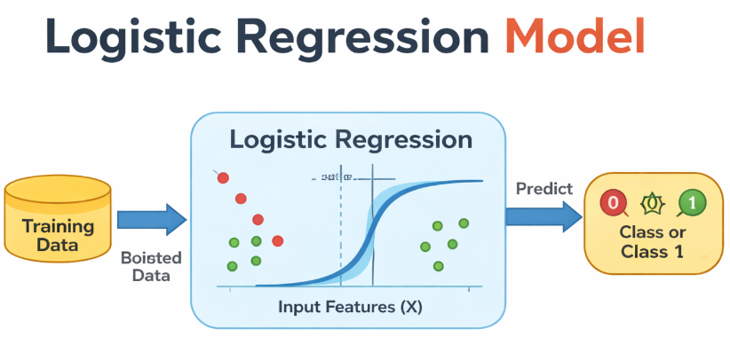
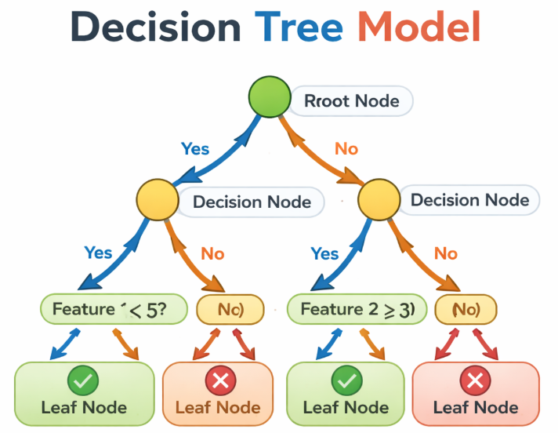
Machine Learning Models:
Model 1 – Logistic Regression:
Logistic Regression is a classification algorithm used to predict categorical outcomes.
Used to classify incidents as Murder or Non-Murder
Works based on probability
Simple and easy to interpret model
Model 2 – Decision Tree:
Decision Tree is a supervised learning algorithm used for classification.
Splits data into branches based on conditions
Easy to understand and visualize
Can handle both numerical and categorical data

Slide 8
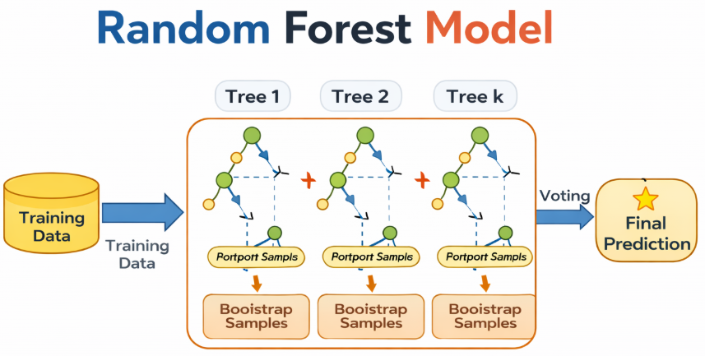
Model 3 – Random Forest:
Random Forest is an ensemble learning method.
Combines multiple decision trees
Reduces overfitting
Provides higher accuracy compared to a single tree
Model 4 – Gradient Boosting:
Model 5 – XGBoost:
Gradient Boosting improves model performance by correcting errors.
Builds models sequentially
Each model improves the previous one
Good for complex patterns
XGBoost is an advanced boosting algorithm.
Faster and more efficient
Handles large datasets well
Provides high accuracy

Slide 9
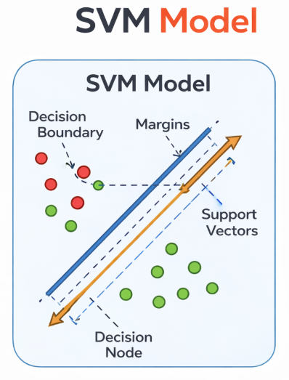
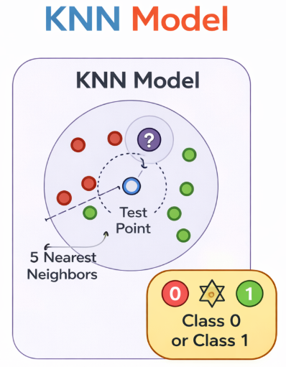
Model 6 – Support Vector Machine (SVM):
SVM is used for classification tasks.
Finds the optimal boundary between classes
Works well with high-dimensional data
Effective for complex datasets
Model 7 – K-Nearest Neighbors (KNN)
KNN is a simple classification algorithm.
Classifies based on nearest data points
Easy to implement
Performance depends on value of K

Slide 10
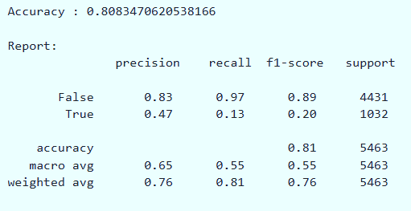
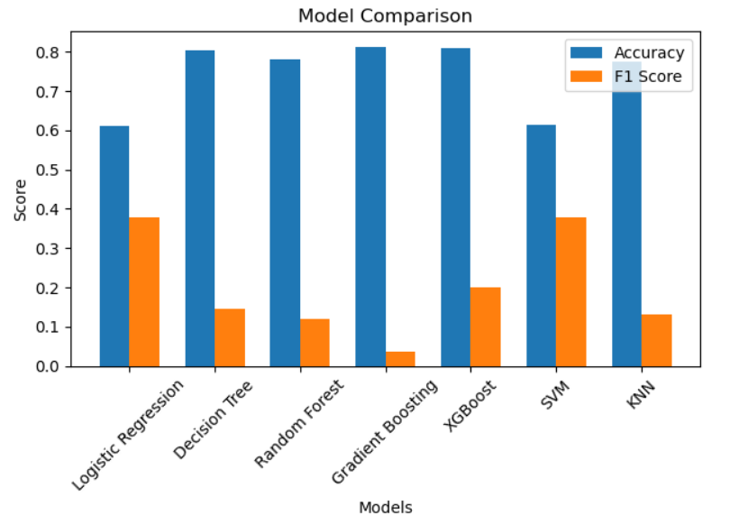
Model Evaluation:
Metrics used:
Accuracy
Precision
Recall
F1 Score
Model Comparison:
Different models are compared based on performance metrics.
Some models provide better accuracy
XGBoost model perform better
Final model is selected based on best results

Slide 11
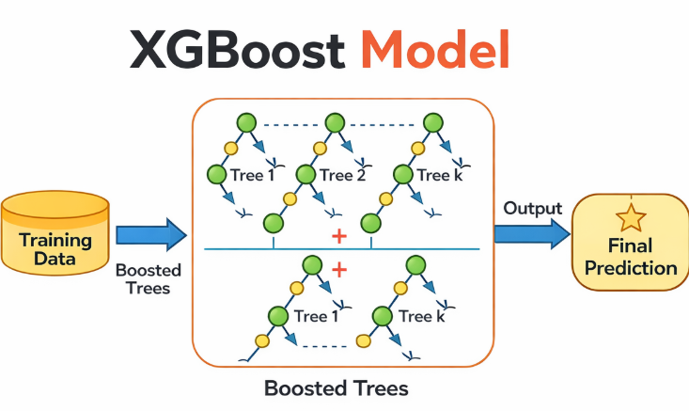
Model Result:
Among all models, XGBoost provided the best performance.
Achieved an accuracy of 80.83%
Demonstrated strong performance in predicting non-murder (False) cases
Precision for non-murder cases is high, indicating reliable predictions
However:
The model shows lower performance for murder (True) cases
Recall for murder cases is low, meaning some true cases are not detected

Slide 12
Conclusion:
This project successfully analyzed NYPD shooting incident data using data analytics and machine learning techniques.
Identified key patterns in time, location, and demographics
Built multiple machine learning models for classification
XGBoost achieved the best performance with highest accuracy
Developed an interactive Power BI dashboard for better visualization
Overall, the project provides meaningful insights that can help in understanding crime trends and support decision-making.

Slide 13

Future Scope:
Apply advanced machine learning techniques to improve prediction accuracy
Handle data imbalance using techniques like SMOTE or resampling
Develop real-time crime monitoring dashboards
Integrate additional data sources (weather, population, etc.)
Build a web or mobile application for easy access

Slide 14
Thank You

